Slide 1
E-R Diagram: Subclass,
E-R to relational design
CS 4710
Database Systems

Slide 2
Course Announcements
Project Phase 2 due on 02/20
Assignment 1 due on 02/13
Course calendar: https://docs.google.com/spreadsheets/d/1QEXtib2QHE9eCnLVg2DY2obcndftr54ly-EiPqGJQNk/edit?gid=0#gid=0

Slide 3
E-R Diagram: Building Blocks
revisit
(strong) Entity set
Attribute Relationship
Weak entity
Subclass
is a
Note: colors are not part of E-R Diagram. They simply are used to increase readability.

Slide 4
Cardinality (or Multiplicity)
A binary relationship can connect any member of one of its entity sets to any number of members of the other entity set
One-to-one
One-to-many
Many-to-one
Many-to-many

Slide 5
Cardinality: One-to-One
product company
pid | name | description |  | name | address
11 | Beyblade | … |  | Dreamwork | …
22 | Trolls | … |  | Hashbro | …
… | … | … |  | Nyform | …
person
owns
passport
Arrow pointing to the entity that is constrained to one
Arrow pointing to the entity that is constrained to one
Each passport can be owned by at most one person. Each person can own at most one passport.
“at most one” – Guarantee existence?
Note: instances do not exist in E-R. These tables are only to help visualize the database being designed.

Slide 6
Example
each student has one backpack, and that each backpack belongs to one student.
One person has one passport, and the passport can only be used by one person.
One family lives in one house, and the house contains one family.
One person owns one car, and the car is owned by one person.

Slide 7
Cardinality: One-to-Many
product company
pid | name | description |  | name | address
11 | Beyblade | … |  | Dreamwork | …
22 | Trolls | … |  | Hashbro | …
… | … | … |  | Nyform | …
mother
child
mother of
Arrow pointing to the entity that is constrained to one
Each mother can have many children. Each child has one mother.
“at most one” and “many” – Guarantee existence?
Note: instances do not exist in E-R. These tables are only to help visualize the database being designed.

Slide 8
Example
parent-child relationship
book authors and their books
websites with multiple web pages

Slide 9
Cardinality: Many-to-Many
product company
pid | name | description |  | name | address
11 | Beyblade | … |  | Dreamwork | …
22 | Trolls | … |  | Hashbro | …
… | … | … |  | Nyform | …
product
makes
company
Each product can be made by many companies. Each company can make many products.
“many” – Guarantee existence?
Note: instances do not exist in E-R. These tables are only to help visualize the database being designed.

Slide 10
Example
Students and Courses
Teacher and students
Library books and borrowers

Slide 11

Subclassing
An entity set may contain entities that have special properties not associated with all members of the set
Subclasses ~ special-case entity sets
Isa (or Is-a) ~ special kind of relationship (one-to-one)
price
category
Similar to classes in OO (super-classes and
sub-classes)
name
product
Generalization
is a
is a
Specialization
Specialization
edu_product
software
The triangle points to the specialization
age_group
platforms

Slide 12
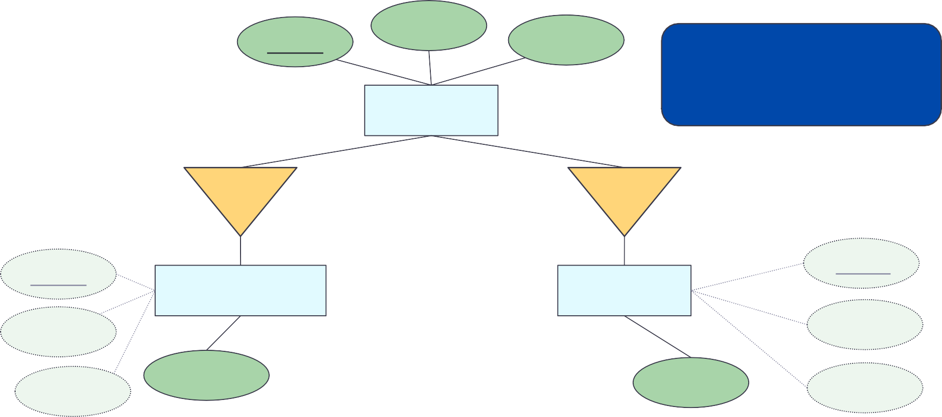

Subclassing
Subclasses are mutually exclusive
name
price
category
Subclasses implicitly inherit superclass key and attributes
product
is a
is a
name
name
edu_product
software
price
price
category
age_group
platforms
category
Generalization / Specialization
The triangle points to the specialization

Slide 13
Let’s try: Subclassing (Movies)
Consider the following (partial) description of a movie scenario.
Each
movie
has a title and year; title and year together uniquely
identify the movie. Length and genre are maintained for each movie.
Among the special kinds of movies, we might store in our database
are
cartoons
and murder mysteries.
A cartoon has, in addition to the attributes and relationships of Movies, an additional relationship called Voices that gives us a set of stars who speak, but do not appear in the movie. Movies that are not cartoons do not have such stars.
Murder-mysteries have an additional attribute weapon.
Draw an E-R diagram to show the connections among the three entity sets: Movies, Cartoons, and Murder-Mysteries.

Slide 14
Done with the building blocks
Let’s transition to design decision
and converting E-R diagram into Relational designs

Slide 15
Recap: Entity vs. Attribute
What are main differences between entities and attributes?
Entities can model situations that attribute cannot model naturally
Entities can participate in relationships
Entities can have attributes
Attributes cannot do any of these

Slide 16
Design Decision
Should “price” be an entity or an attribute?
For each tuple (person, product, vendor), there is a value of price
price
personID
person
buys
product
productID
vendor
vendorID

Slide 17
Design Decision (2)
“price” as an entity
price
amount
personID
person
buys
product
productID
vendor
vendorID
Since “price” is just the actual amount, treating it as an attribute is adequate. No need to make it an entity
“price” as an attribute
price
personID
person
buys
product
productID
vendor
vendorID

Slide 18
Decisions to Make
Entity set vs. attributes
Has more data
Is the data
→ entity set
→ attribute
Entity set vs. relationship set
Entity set
Relationship
→ nouns (students, faculty, loads, …)
→ possession verbs (teaches, advises, owns, works for, …)
Binary vs. n-ary relationship sets
Specialization / generalization

Slide 19
Rules of Thumb
Pick the right entities
Keep it simple
Don’t over complicate things
Choose the right elements (entities vs. attributes)
Choose the right relationships
Follow the specification of the application to be built
Avoid NULL value
Avoid redundancy
Consider small number of tables

Slide 20
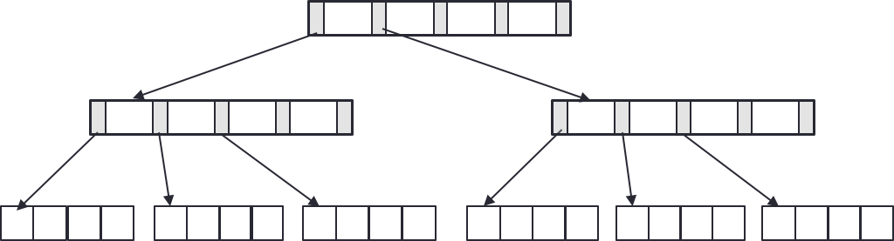
 | revisit
Database Design Process
Interact with users and domain experts to characterize the data
Translate requirements into conceptual model (E-R diagrams)
Convert the model to relational model (schema and constraints)
Normalize and develop conceptual (logical) schema of the database
Develop physical schema (partitioning and indexing)

Slide 21
E-R Diagrams to Relations
There is a unique table which is assigned the name of the corresponding entity set or relationship set
name
cname
address
pid
description
product
makes
company
product(pid, name, description) company(cname, address) makes(cname, pid)
“Schema statement”
[ER to schema worksheet]

Slide 22
Strong Entity Set
Direct map:
Entity name → relation name Attributes → columns Primary key: same as entity
name
cname
address
pid
description
product
makes
company
product(pid, name, description) company(cname, address) makes(cname, pid)

Slide 23
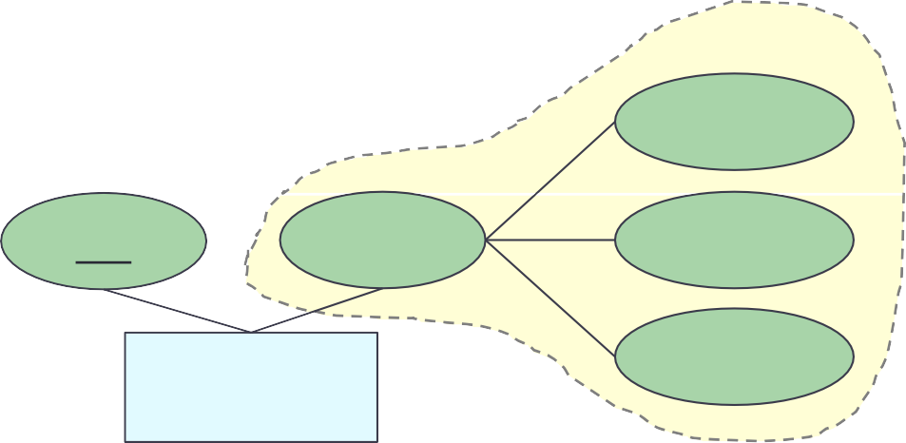
Strong Entity Set with Composite Attribute
Create separate attributes for each component Don’t include the higher level attribute
first
pid
name
middle
person
last
person(pid, first_name, middle_name, last_name)

Slide 24
Strong Entity Set with Multivalued Attribute
Create a separate table for the multivalued attribute
Name the table with the concatenation, separated by “_”
entityname_attributename
Primary key: all attributes
pid
name
phone
person
person(pid, name) person_phone(pid, phone_number)

Slide 25
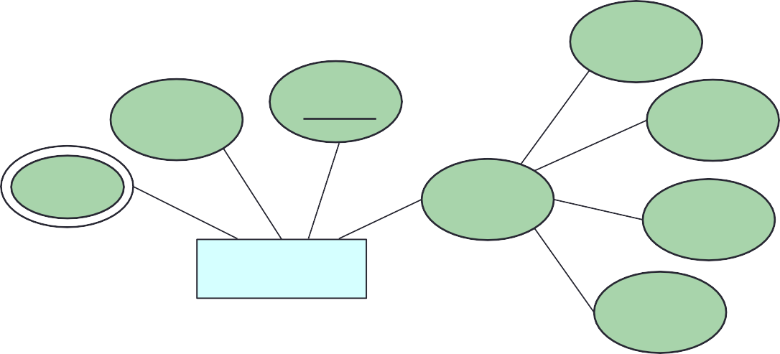
Let’s try: E-R to Relations (1)
Convert the following E-R diagram into relations
street
name
S_ID
city
phone
address
state
student
zip code
student (S_ID, name, street, city, state, zip code) student_phone (S_ID, phone)
PK of this table is a combination
of all attributes

Slide 26
Weak Entity Set
Let A be a weak entity set and B be the identifying strong entity set on which A depends
Create a table with primary key of B and all A’s attributes Primary key: primary key of B (strong entity) and
discriminator of A
hw_number
c_number
title
due_date
homework
have
course
total_scores
course(c_number, title)
homework(c_number, hw_number, due_date, total_scores)

Slide 27
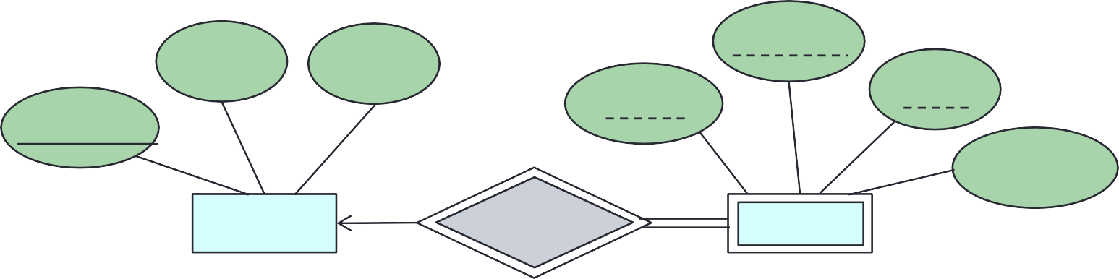
Let’s try: E-R to Relations (2)
Convert the following E-R diagram into relations
title
semester
credits
sec_id
year
course_id
enroll_limit
course
sec_course
section
course (course_id, title, credits)
section (course_id, sec_id, semester, year, enroll_limit)

Slide 28
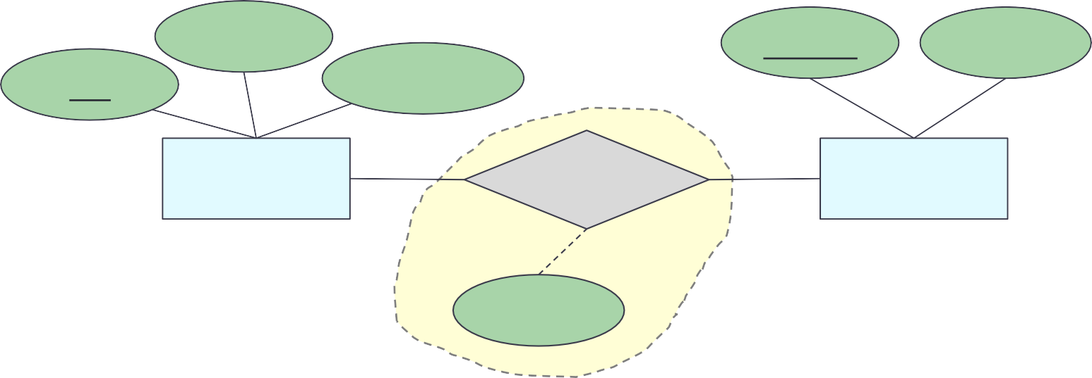
Relationship Set: Many-to-Many
Table: primary keys of both participating entity sets and any attributes on the relationship itself
Primary key: primary keys of both participating entity sets
name
cname
address
pid
description
product
makes
company
quantity
product(pid, name, description) company(cname, address) makes(pid, cname, quantity)
Primary keys of both entities

Slide 29
Let’s try: E-R to Relations (3)
Convert the following E-R diagram into relations
name
salary
name
dept_id
instr_ID
instructor
work_for
department
instructor (instr_ID, name, salary) department (dept_id, name) work_for (instr_ID, dept_id)

Slide 30
Let’s try: E-R to Relations (4)
Convert the following E-R diagram into relations
date
name
name
salary
S_ID
total_cred
instr_ID
instructor
advisor
student
instructor (instr_ID, name, salary) student (S_ID, name, total_cred) advisor (instr_ID, S_ID, date)

Slide 31
Relationship Set: Many-to-One / One-to-Many
Table: primary keys of both participating entity sets and any attributes on the relationship itself
Primary key: primary keys of the entity set on the “many” side
mother
child
mother of
Arrow pointing to the entity that is constrained to one
mother(SSN, name)
child(SSN, name)
motherOf(ChildSSN, motherSSN)
Each mother can have many children. Each child has one mother.
“at most one” and “many” – Guarantee existence?
Note: instances do not exist in E-R. These tables are only to help visualize the database being designed.

Slide 32

Relationship Set: Many-to-One / One-to-Many
Table: primary keys of both participating entity sets and any attributes on the relationship itself
Primary key: primary keys of the entity set on the “many” side
name
cname
address
pid
description
product
makes
company
quantity
product(pid, name, description) company(cname, address) makes(pid, cname, quantity)
Primary key of the “many” side

Slide 33
Let’s try: E-R to Relations (5)
Convert the following E-R diagram into relations
name
salary
name
dept_id
instr_ID
instructor
work_for
department
instructor (instr_ID, name, salary) department (dept_id, name) work_for (instr_ID, dept_id)

Slide 34
Relationship Set: One-to-One
Table: Either side can be used as the main table
(Which side? doesn’t matter. Pick the one that makes the most sense)
Add the other side’s primary key to it
Primary key: primary keys of the entity set you pick
person
owns
passport
Arrow pointing to the entity that is constrained to one
Arrow pointing to the entity that is constrained to one
Each passport can be owned by at most one person. Each person can own at most one passport.
person(SSN, name)
passport(passportNo, SSN)
Note: instances do not exist in E-R. These tables are only to help visualize the database being designed.

Slide 35
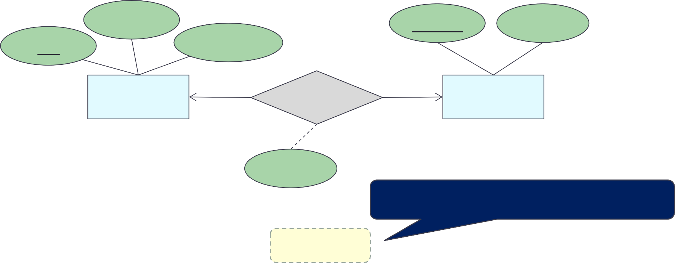
Relationship Set: One-to-One
Table: Either side can be used as the main table
(Which side? doesn’t matter. Pick the one that makes the most sense)
Add the other side’s primary key to it
Primary key: primary keys of the entity set you pick
name
cname
address
pid
description
product
makes
company
quantity
Primary key of the chosen entity
product(pid, name, description) company(cname, address, pid, quantity)

Slide 36
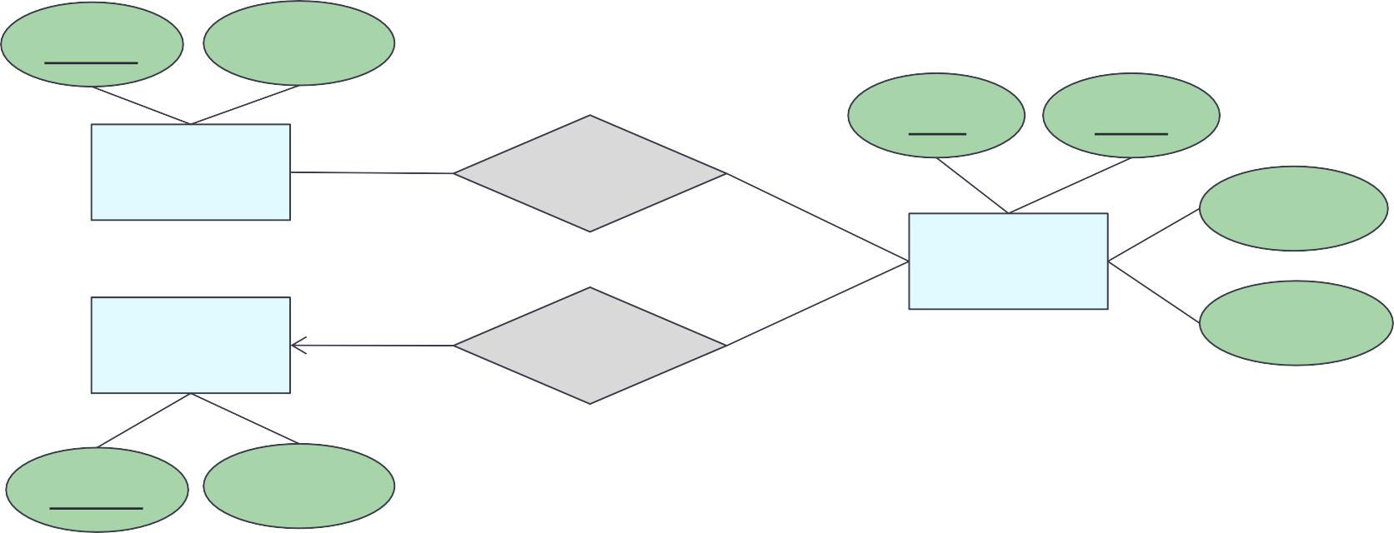
Let’s try: E-R to Relations (7)
Convert the following E-R diagram into relations
name
address
title
year
stars
stars-in
genre
movies
studios
owns
length
name
address
stars(name, address)
studios(name, address) movies(title, year, genre, length)
stars-in(title, year, starsName)
owns(title, year, studioName)

Slide 37
Let’s try: E-R to Relations (8)
Convert the following E-R diagram into relations
number
day
aircraft
flights
to_flight
row
bookings
custID
seat
customers
to_cust
name
phone address
flights(number, day, aircraft) customer(custID, name, phone, address) bookings(number, day, custID, row, seat)

Slide 38
Let’s do some practice
Consider a university database system with the following entities: Student, Course, and Instructor. Each student is uniquely identified by a student ID and has attributes such as name, address, and date of birth. Each course is uniquely identified by a course code and has attributes such as title and credit hours. Each instructor is uniquely identified by an instructor ID and has attributes such as name and department.
A student can enroll in multiple courses, and each course can have multiple enrolled students.
An instructor can teach multiple courses, and each course is taught by one instructor.
Ensure that your ER diagram captures these relationships and provides a clear representation of the database structure. Convert the given ER model to Relational Model.

Slide 39
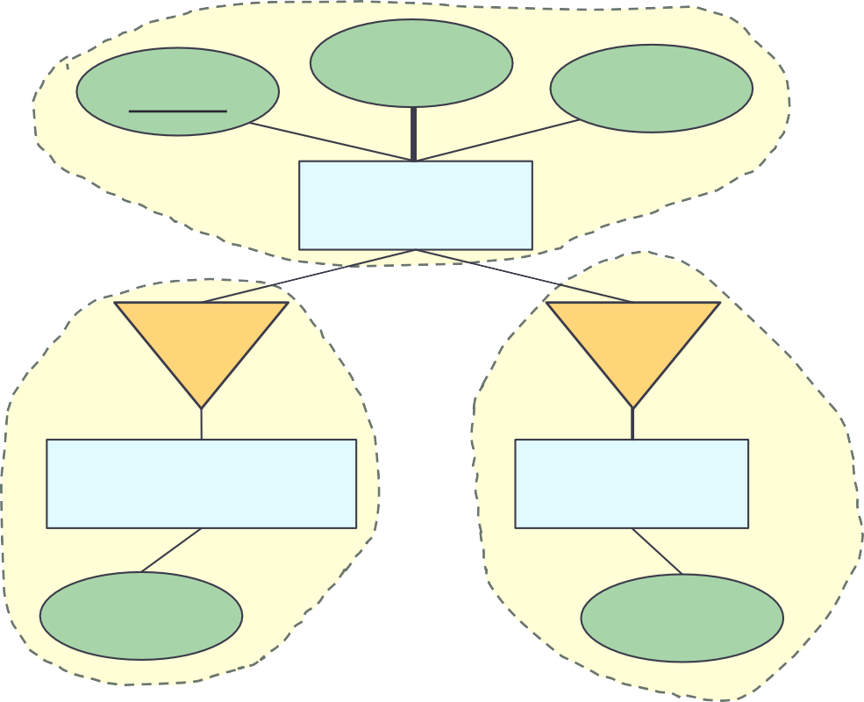
Subclass (Option 1)
price
Keep everything
Primary key of the lower level entity set: from the higher level
Drawback: need to access more tables to get info about the lower levels
name
category
product
is a
is a
edu_product
software
age_group
platforms
product(name, price, category) edu_product(name, age_group) software(name, platforms)
Keep everything

Slide 40
Subclass (Option 2)
Keep specialization entity sets No table for generalization entity
set
name
price
category
product
Primary key of the lower level entity set: from the higher level
is a
is a
edu_product
software
Drawback: redundancy if entities have more than one specialization
age_group
platforms
edu_product(name, price, category, age_group) software(name, price, category, platforms)
Push down

Slide 41
Subclass (Option 3)
Keep generalization entity set No table for specialization entity
sets
name
price
category
product
is a
is a
Drawback: NULL in attributes from specialization
entity sets
edu_product
software
Although less duplication of data, need to handle NULL value
age_group
platforms
Push up
product(name, price, category, age_group, platforms)

Slide 42

Subclass: Design Decision
Depending on the number of attributes of the generalization entity set and specialization entity set
If balanced → do option 1 (create all)
If more attributes in specialization → do option 2
If more attributes in generalization → do option 3
In general, design decision depends on
The number of attributes
DB administrator’s decision
Overall goal: minimize duplication (there is no one correct way)

Slide 43
Let’s do some practice
Design an ER diagram for a library management system. The entities include:
A book is uniquely identified by a BookID, with attributes Title, Author, and Genre.
A member is uniquely identified by a MemberID, with attributes Name, Address, and MembershipDate.
A librarian is uniquely identified by a LibrarianID, with attributes Name and Role.
A member can borrow multiple books, and a book can be borrowed by multiple members over time. A librarian is responsible for issuing and receiving books for members.
Create an ER diagram to represent the database.
Convert the ER model into a relational model.

Slide 44
Wrap-Up
Roles in Relationships
Relationships: binary, u-ary
Weak entity
Subclasses
Converting from E-R diagrams to relational designs
Turn each entity set into a relation with the the same set of attributes
Replace a relationship by a relation whose attributes are the keys for the connected entity sets
Weak entity sets cannot be translated straightforwardly to relations
“Is a” relationships and subclasses require careful treatment
What’s next?
Apply the concept to database scenarios and fine-tuning database structure

